Slide 1
IAAF 2021
Adopting and Aligning to the ICT Testing Baseline
October 2021
Notes:
Hello and welcome to, “Adopting and Aligning to the ICT Testing Baseline”

Slide 2



Introduction
Kathy Eng US Access Board
Andrew Nielson General Services Administration
Michael Horton General Services Administration
Notes:
My name is Michael Horton, I am with the General Services Administration, and I am joined today by my colleagues Andrew Nielson, also with the General Services Administration

Slide 3
Agenda
ICT Testing Baseline
Elements of the ICT Testing Baseline Alignment Framework
Feedback and Contributions
Framework Rollout Milestones
Notes:
During today’s presentation we will introduce you to the ICT testing baseline, elements of the ICT testing baseline alignment framework, share information on how you can provide feedback and be a contributor to the ICT Testing Baseline Working Group, and share with you a high-level timeline of key milestones of the Baseline rollout.
After our presentation, we look forward to answering any questions you might have about the ICT Testing Baseline.

Slide 4

Section 508 Testing Challenges
Interpretation of standards vary
Variety of testing methods
Many approaches to manual testing
Lots of automated testing tools
Inconsistent test results
Notes:
I’m going to start off with describing the challenges of Section 508 testing, which is not news to most of us:
Interpretation of standards and requirements may vary from person to person, agency to agency. We all want ICT to be accessible, but what does it mean to be conformant to the standards?
We have a plethora of options when it comes to testing methodologies or how to test:
Manual testing includes using assistive technology, code inspection. Here, a human tester evaluates and determines test results.
Many automated testing tools are available for web testing. And each of these tools have their own set of rulesets that they use to test and evaluate to report results.
With all of this variety, we get test results that are inconsistent from one tester to another. Federal agencies, and I’m sure other organizations, are struggling with being able to trust test results for a product because we don’t know where these results came from.

Slide 5

ICT Testing Baseline for Web
Revised Section 508
(WCAG 2.0)
WHAT
Needs to be checked

Slide 6
Baseline for Web
24 Baseline Categories
91 tests results
43 Section 508 requirements
(37) WCAG SCs
(2) WCAG Conformance Requirements
(3) 508 Media Player CC and AD
Keyboard Accessible
Focus
Non-Interference
Repetitive Content
Changing Content
Images
Sensory Characteristics
Contrast
Flashing
Forms
Page Titles
Tables
Content Structure
Links
Language
Audio-Only and Video-Only
Synchronized Media
CSS Content and Positioning
Frames and iFrames
Conforming Alternate Version
Timed Events
Resize Text
Multiple Ways
Parsing
Notes:
- There are 38 A and AA SCs but we 1.2.3 Audio Description or Media Alternative (Prerecorded)- Level A is superceded by 1.2.5 Audio Description (Prerecorded)-Level AA, so Baseline has 37.
- WCAG Conformance 1 (Conforming Alternate Version) and 5 (Non-Interference)
- Section 508: 503.4 User Controls for Captions and Audio Description and it’s sub-provisions for control levels

Slide 7
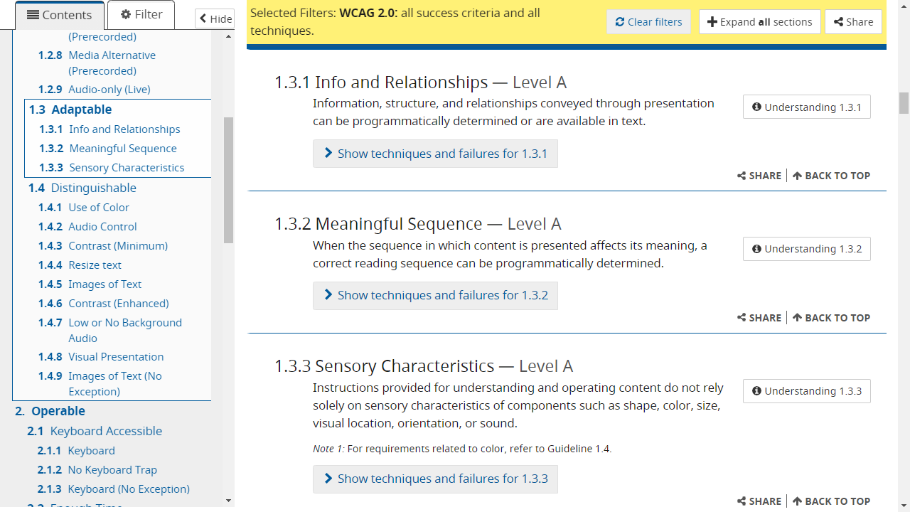
WCAG Success Criteria

Slide 8
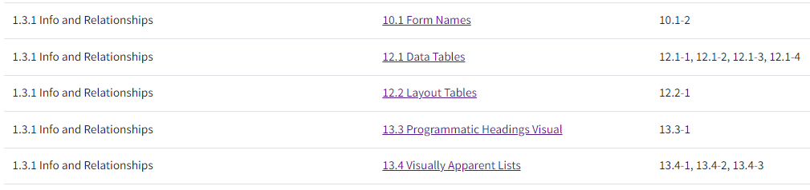
10 Baseline Tests for WCAG SC 1.3.1
Notes:
Screenshot of Baseline Tests mapped to SC 1.3.1 in the following categories: Forms, Data Tables, Layout Tables, Visual Headings, Visually Apparent Lists. Total of 10 tests for one SC.

Slide 9
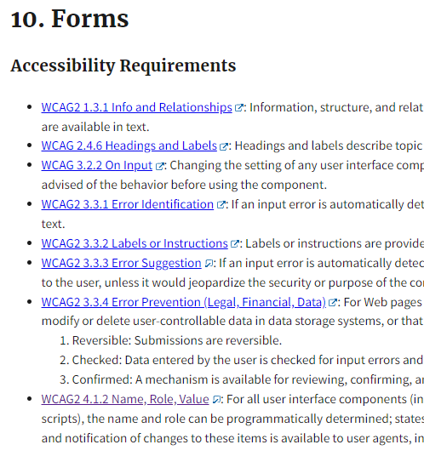
Forms Baseline
8 WCAG SCs
7 Baseline Tests
Test for Form name covers 2 SCs (4.1.2 and 1.3.1)
Notes:
Screenshot of Forms, listing 1.3.1 as one of 8 WCAG Accessibility Requirements tested in this Baseline.
One Baseline test for Form Name covers 4.1.2 and 1.3.1.

Slide 10
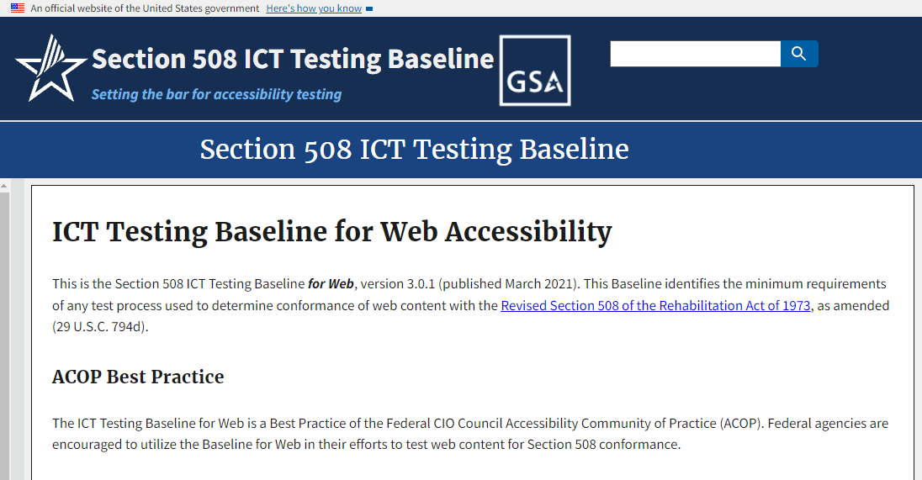
ICT Testing Baseline for Web home page
Notes:
New home for web site.
ACOP Best Practice, version 3.0.1.

Slide 11
ICT Testing Baseline for Web - URL and Contact info
https://ictbaseline.access-board.gov
ICTBaseline@gsa.gov

Slide 12
Baseline-aligned Test Process
HOW
to test
Test Process
Test Tools

Slide 13
Baseline-aligned Test Process - Consistent Test Results
Trusted Tester
Test Process B
Test Process C
Consistent Section 508 Test Results

Slide 14
The ICT Testing Baseline Portfolio
Establish the foundation for consistent 508 test results
Web Baseline (done)
Baseline for all ICT covered by Section 508
In progress, with contributors from many agencies
Baseline for Documents
Baseline for Hardware
Reporting Requirements
Baseline for Web Alignment Framework
Notes:
Participating agencies: USAB, GSA, DHS, OPM, EPA, HHS, plus more. SSA has recently joined in to help.

Slide 15
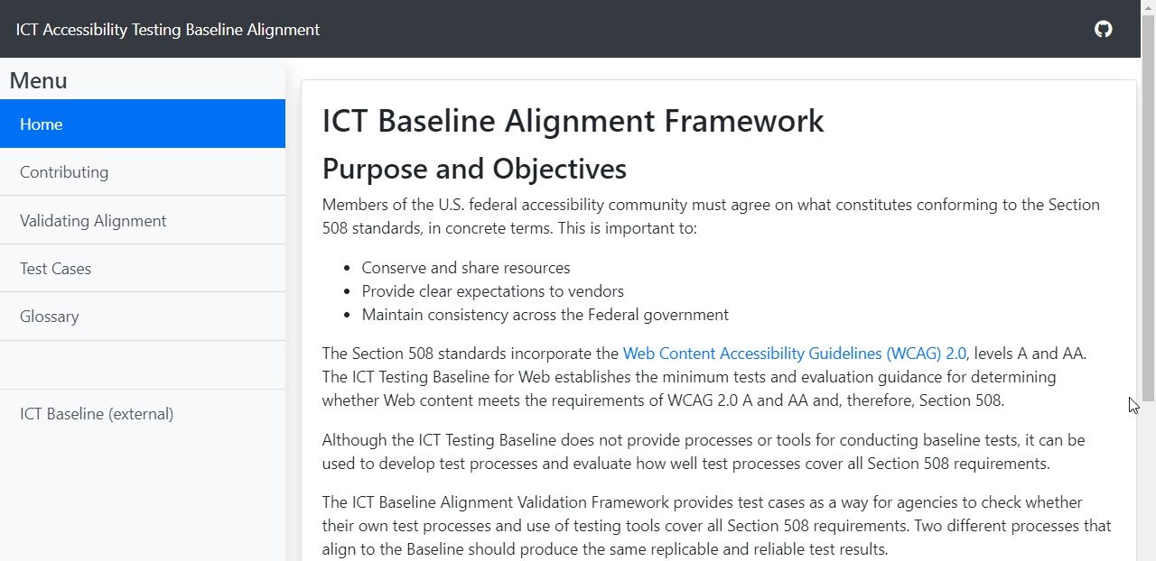
ICT Baseline Alignment Framework
https://section508coordinators.github.io/baslinealignment/

Slide 16
Elements of the ICT Testing
Baseline Alignment Framework
Test steps
Data input: code samples
Test Case
✔
✔
🗶
</>

Slide 17
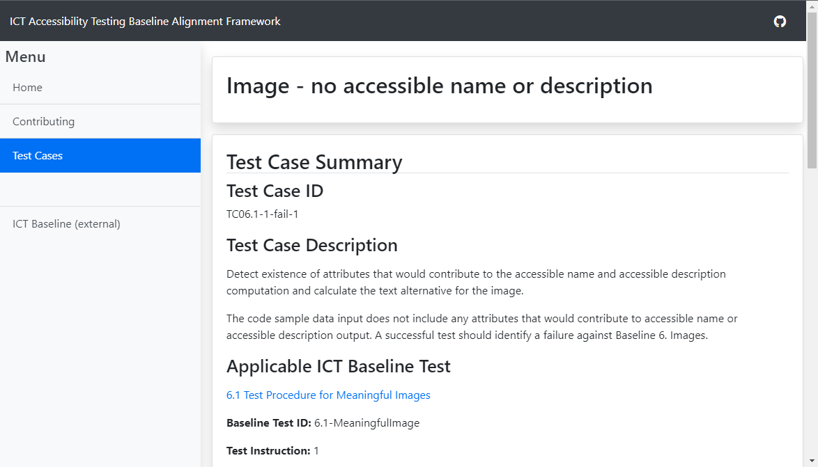
Test Case Description (title, test ID)

Slide 18
Test Case Description

Slide 19
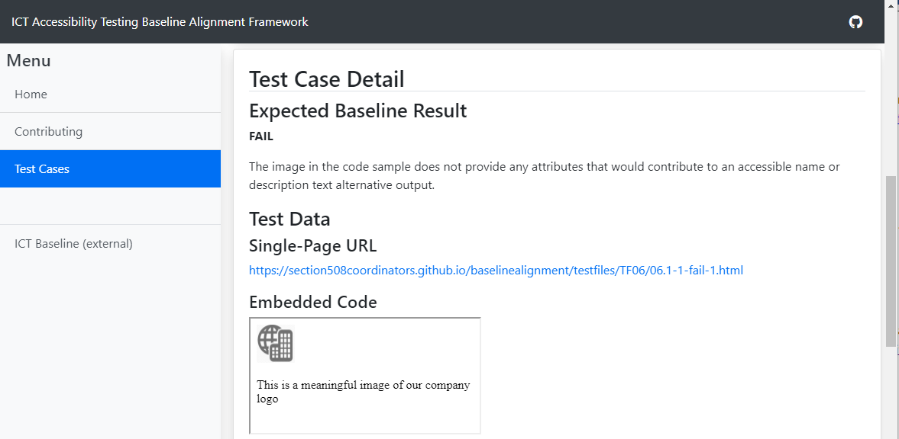
Test Case Detail (result, URL, embedded code)

Slide 20
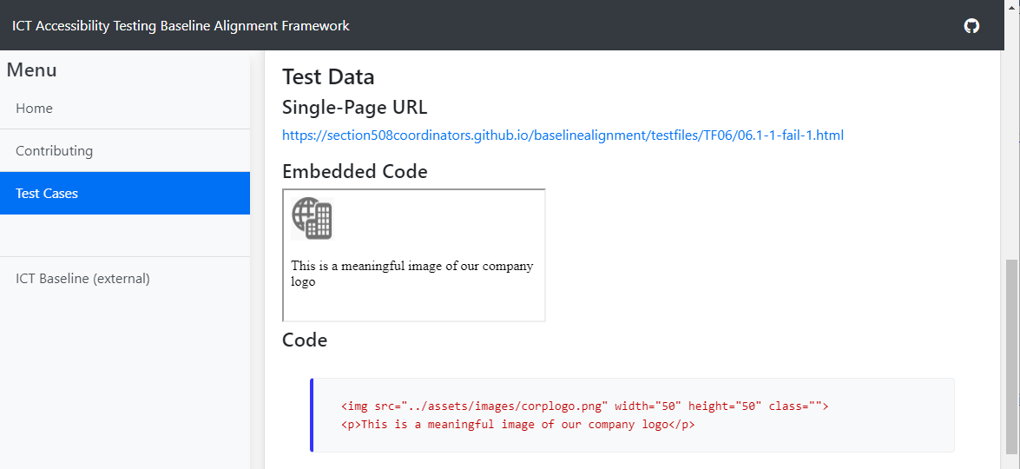
Test Case Detail (Test Data; Code snippet)

Slide 21
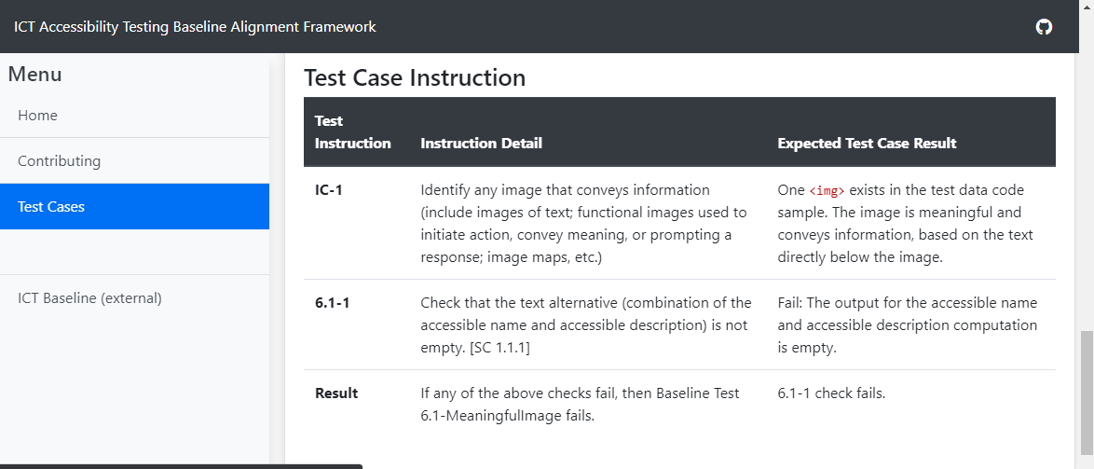
Test Case Description (test steps)

Slide 22
Alignment Validation Tools
Traceability Matrix
Alignment Validation Report Template
JavaScript Object Notation (JSON) file of test case info

Slide 23
Validation Methods
Government Representative Validation
3rd-Party Accreditation (3PAO)
Self-Assessment and Attestation
Some Combination

Slide 24
Validation Steps
Self Assessment
Submit Request for Validation
Independent Validation

Slide 25

Baseline Governance Board

Slide 26

Baseline Governance Board - Organization
Authorizing Officials
Technical Advisory

Slide 27
Baseline Governance Board - Authorizing Officials v. Technical Advisory
Authorizing Officials
Technical Advisory
Designate Technical Advisory Representative
Review input and feedback
Monitor trends
Adjudicate proposed changes
Propose changes
Evaluate impact of changes
Advise Authorizing Officials
Notify stakeholders

Slide 28
Feedback and Contributions
Like the Section 508 ICT Testing Baseline for Web, the ICT Baseline Alignment Framework is hosted on GitHub as a platform to facilitate feedback and contributions to the alignment framework and test cases.
The ICT Testing Baseline Working Group (ITBWG) welcomes feedback from government and industry web development and accessibility testing communities to ensure the maintenance of the Baseline in accordance with established web-based technologies.

Slide 29
Provide Feedback
Individuals interested in providing feedback should contact the ITBWG by:
Sending an email to ictbaseline@gsa.gov, with feedback which:
Includes your full name, email address, phone number, and agency or business
Specifies the baseline test(s) being discussed in your feedback
Sufficiently describes the issue(s), with any recommendation(s) and reference(s)
Creating an “issue” in the GitHub repository (for the ICT Testing Baseline or for the Baseline Alignment Framework)
Creating your own fork of the ICT Testing Baseline or Baseline Alignment Framework GitHub repository and submit pull requests to propose changes directly

Slide 30
Become a Contributor
Participation in the ICT Testing Baseline Working Group (ITBWG) is open to government employees and representatives who specialize in the development and testing of web-based products. The ITBWG welcomes the support of contributors in various areas of focus including, but not limited to:
Test case developers
Requirements officials
Change management officials
Technical writing
Administrative support
Section 508 SMEs
IT testing specialists
Eligible individuals interested in becoming a contributor should contact the ITBWG at ictbaseline@gsa.gov.
Notes:
Participation in the ICT Testing Baseline Working Group (ITBWG) is open to government employees and representatives who specialize in the development and testing of web-based products. As a member of this all-volunteer governing body, individuals will support the continued development, maintenance and promotion of the Baseline.
Reflecting the same set of skills and expertise necessary for implementing Section 508 across an agency’s IT portfolio, the ITBWG welcomes the support of contributors in various areas of focus including, but not limited to:
Test case developers
Requirements officials
Change management officials
Technical writing
Administrative support
Section 508 SMEs
IT testing specialists
Eligible individuals interested in becoming a contributor should contact the ITBWG at ictbaseline@gsa.gov.

Slide 31
Framework Rollout Milestones
The following table represents a high level timeline of key milestones of the Baseline rollout.
Milestone | Timeline
Finalization of the Section 508 ICT Testing Baseline | Phase 1
Formal adoption of the ICT Baseline by OMB and/or the Federal Chief Information Officers’ Council | Phase 1
Designation and allocation of resources to support ongoing governance | Phase 2
Start date for accepting recommendations and proposals for validation of test processes and tools from federal agencies | Phase 2
Finalization of the ICT Baseline Alignment Validation process and test cases | Phase 2
Anticipated turnaround time for alignment validation of individual processes and tools | Phase 3
Pilot the Validation process with two-three federal agencies | Phase 3
Notes:
This slide contains a simple data table which represents a high level timeline of key milestones and phased rollout of the Baseline.

Slide 32
What Organizations Can Do to Prepare for and Adopt the ICT Baseline
While practical adoption of the Baseline will necessitate use of the validation framework, agencies may be interested in an initial review of their products for alignment to the Baseline. Organizations may find some benefit to reviewing the Baseline in order to gain some insight into any possible adjustments that may be necessary for successful validation. A preliminary review might include:
Evaluating existing test processes for possible adoption and implementation in an organization’s system development processes
Evaluating testing tools for possible incorporation in test processes
Modifying existing processes to align to the ICT Baseline
Combining automated and manual testing processes in system development processes

Slide 33
Review / Summary
Simplify the testing of “things on a page”
“Categories of testing” ensure consistency of results
Allows users to select mode of testing that fits their needs
First in a series of testing Baselines
Foundation for consistent test results for all Section 508 requirements
The Baseline Alignment Framework test cases enable validation of alignment
Visit: https://ictbaseline.access-board.gov
Contact us at: ictbaseline@gsa.gov
Notes:
Why the Baseline was needed -
“Categories of testing” ensure consistency of results
Results are consistent between automated and manual tests
Baseline for Web is the first in a series of testing Baselines
A foundation for consistent test results for all Section 508 requirements
Section 508 testing challenges and the need for a consistent way to test for accessibility
Baseline tests are grouped into categories of testing of applicable requirements
Baseline for web is the first in a series of baselines (e.g., software, hardware, documents)
Baseline tests enable the agencies to define testing processes and inspection tools
Trusted Tester is an example of a Baseline-aligned, manual testing process
Baseline for web supports hybrid testing procedures that combine manual/automated
The “Big Picture” - A foundation for consistent test results for all Section 508 requirements

Slide 34
Questions?

